Slide 1


CONTEMPORARY ORGANISATIONAL DESIGN
UNIT 7

Slide 2
LEARNING OUTCOME
Describe contemporary organizational designs.
Discuss how organizations organize for collaboration.
Explain flexible work arrangements used by organizations.
Discuss organizing issues associated with a contingent workforce.
Describe today’s organizational design challenges.

Slide 3
CONTEMPORARY ORGANIZATIONAL DESIGNS
Team Structure - an organizational structure in which the entire organization is made up of work teams
Matrix Structure - an organizational structure that assigns specialists from different functional departments to work on one or more projects
Notes:
A team structure is one in which the entire organization is made up of work teams that do the organization’s work. In this structure, employee empowerment is crucial because no line of managerial authority flows from top to bottom. Rather, employee teams design and do work in the way they think is best, but the teams are also held responsible for all work performance results in their respective areas.
Other popular contemporary designs are the matrix and project structures. The matrix structure assigns specialists from different functional departments to work on projects being led by a project manager. (See Exhibit 12-2.) One unique aspect of this design is that it creates a dual chain of command because employees in a matrix organization have two managers: their functional area manager and their product or project manager, who share authority. The project manager has authority over the functional members who are part of his or her project team in areas related to the project’s goals. However, any decisions about promotions, salary recommendations, and annual reviews typically
remain the functional manager’s responsibility. The matrix design “violates” the unity of command principle, which says that each person should report to only one boss; however, it can—and does—work effectively if both managers communicate regularly, coordinate work demands on employees, and resolve conflicts together.

Slide 4
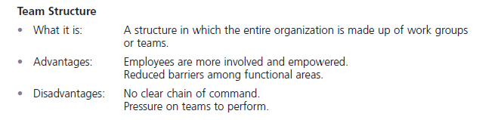
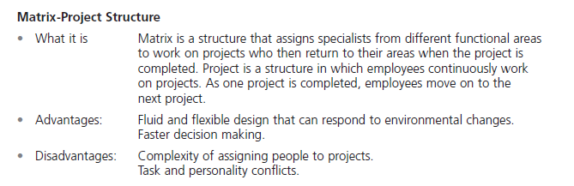
EXHIBIT 12-1 CONTEMPORARY ORGANIZATIONAL DESIGNS

Slide 5
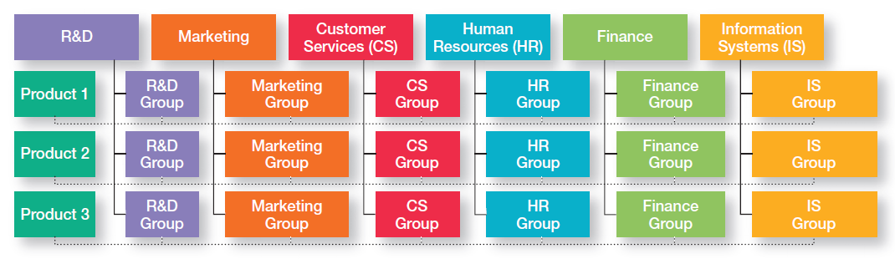
EXHIBIT 12-2 EXAMPLE OF A MATRIX ORGANIZATION

Slide 6
CONTEMPORARY ORGANIZATIONAL DESIGNS (CONT.)
Project Structure - an organizational structure in which employees continuously work on projects
Boundaryless Organization - an organization whose design is not defined by, or limited to, the horizontal, vertical, or external boundaries imposed by a predefined structure
Notes:
Many organizations use a project structure, in which employees continuously work on projects. Unlike the matrix structure, a project structure has no formal departments where employees return at the completion of a project. Instead, employees take their specific skills, abilities, and experiences to other projects. Also, all work in project structures is performed by teams of employees.
The boundaryless organization, is an organization whose design is not defined by, or limited to, the horizontal, vertical, or external boundaries imposed by a predefined structure. Although the idea of eliminating boundaries may seem odd, many of today’s most successful organizations find that they can operate most effectively by remaining flexible and unstructured: that the ideal structure for them is not having a rigid, bounded, and predefined structure.

Slide 7
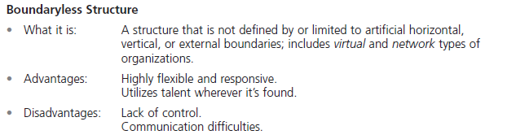
EXHIBIT 12-1 CONTEMPORARY ORGANIZATIONAL DESIGNS (CONT.)

Slide 8

CONTEMPORARY ORGANIZATIONAL DESIGNS (CONT.)
Virtual Organization - an organization that consists of a small core of full-time employees and outside specialists temporarily hired as needed to work on projects.
Notes:
A virtual organization typically consists of a small core of full-time employees and outside specialists temporarily hired as needed to work on projects. An example is when Second Life, a company creating a virtual world of colorful online avatars, was building its software. Founder Philip Rosedale hired programmers from around the world and divided up the work into about 1,600 individual tasks, “from setting up databases to fixing bugs.” The process worked so well, the company used it for all sorts of work.

Slide 9
CONTEMPORARY ORGANIZATIONAL DESIGNS (CONT.)
Network Organization - an organization that uses its own employees to do some work activities and networks of outside suppliers to provide other needed product components or work processes.
Learning Organization - an organization that has developed the capacity to continuously learn, adapt, and change
Notes:
A network organization is one which uses its own employees to do some work activities and networks of outside suppliers to provide other needed product components or work processes. This organizational form is sometimes called a modular organization by manufacturing firms. Such an approach allows organizations to concentrate on what they do best by contracting out other activities to companies that do those activities best.
A learning organization, is an organization that has developed the capacity to continuously learn, adapt, and change. In a learning organization, employees continually acquire and share new knowledge and apply that knowledge in making decisions or doing their work. Some organizational theorists even go so far as to say that an organization’s ability to do this—that is, to learn and to apply that learning—may be the only sustainable source of competitive advantage.

Slide 10
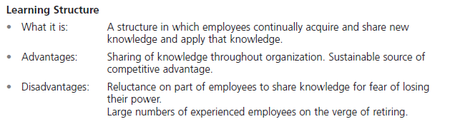
EXHIBIT 12-1 CONTEMPORARY ORGANIZATIONAL DESIGNS (CONT.)

Slide 11
ORGANIZING FOR COLLABORATION
Internal Collaboration
Cross-functional team - a work team composed of individuals from various functional specialties.
Task force (or ad hoc committee) - a temporary committee or team formed to tackle a specific short-term problem affecting several departments.
Notes:
When managers believe collaboration among employees is needed for more coordinated and integrated work efforts, they can use several different structural options. Some of the more popular include cross-functional teams, task forces, and communities of practice.
A crossfunctional team is a work team composed of individuals from various functional specialties. When a cross-functional team is formed, team members are brought together to collaborate on resolving mutual problems that affect the respective functional areas. Ideally, the artificial boundaries that separate functions disappear, and the team focuses on working together to achieve organizational goals.
Another structural option organizations might use is a task force (also called an ad hoc committee), a temporary committee or team formed to tackle a specific short-term problem affecting several departments. The temporary nature of a task force is what differentiates it from a cross-functional team. Task force members usually perform many of their normal work tasks while serving on the task force;
however, the members of a task force must collaborate to resolve the issue that’s been assigned to them. When the issue or problem is solved, the task force is no longer needed and members return to their regular assignments.

Slide 12
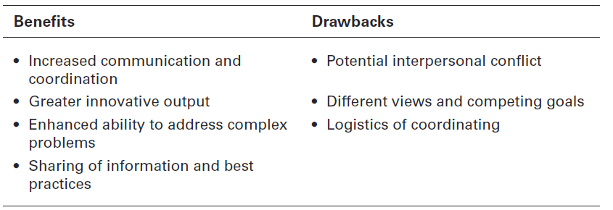
EXHIBIT 12-3 BENEFITS AND DRAWBACKS OF COLLABORATIVE WORK

Slide 13
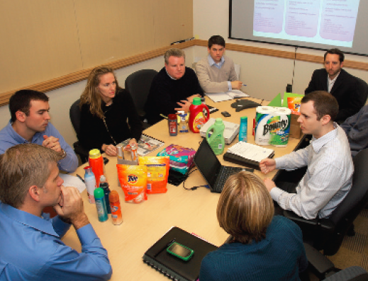
INTERNAL COLLABORATION (CONT.)
Communities of practice - groups of people who share a concern, a set of problems, or a passion about a topic, and who deepen their knowledge and expertise in that area by interacting on an ongoing basis.
Notes:
communities of practice, are types of internal collaborations which are “groups of people who share a concern, a set of problems, or a passion about a topic, and who deepen their knowledge and expertise in that area by interacting on an ongoing basis.

Slide 14
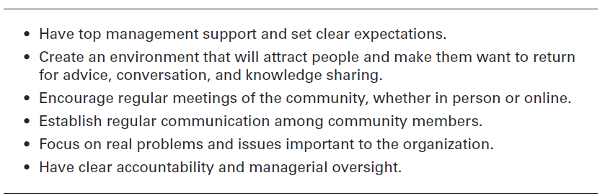
EXHIBIT 12-4 MAKING COMMUNITIES OF PRACTICE WORK

Slide 15
EXTERNAL COLLABORATION
Open innovation - opening up the search for new ideas beyond the organization’s boundaries and allowing innovations to easily transfer inward and outward.
Strategic partnerships - collaborative relationships between two or more organizations in which they combine their resources and capabilities for some business purpose.
Notes:
Today, many companies are trying open innovation, opening up the search for new ideas beyond the organization’s boundaries and allowing innovations to easily transfer inward and outward. For instance, Procter & Gamble, Starbucks, Dell, Best Buy, and Nike have all created digital platforms that allow customers to help them create new products and messages.
In today’s environment, organizations are looking for advantages wherever they can get them. One way they can do this is with strategic partnerships, collaborative relationships between two or more organizations in which they combine their resources and capabilities for some business purpose.

Slide 16
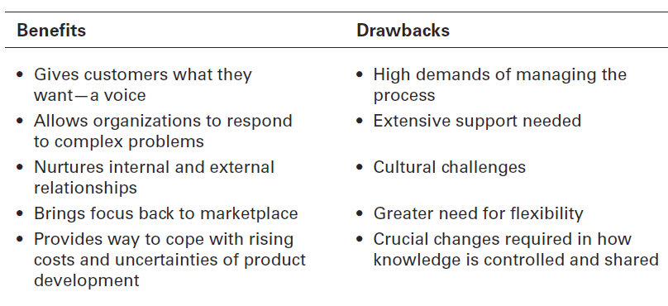
EXHIBIT 12-5 BENEFITS AND DRAWBACKS OF OPEN INNOVATION

Slide 17

FLEXIBLE WORK ARRANGEMENTS
Telecommuting - a work arrangement in which employees work at home and are linked to the workplace by computer.
Compressed workweek - a workweek where employees work longer hours per day but fewer days per week
Notes:
Telecommuting is a work arrangement in which employees work at home and are linked to the workplace by computer. Needless to say, not every job is a candidate for telecommuting, but many are.
One approach to flexible work arrangements is a compressed workweek, a workweek where employees work longer hours per day but fewer days per week. The most common arrangement is four 10-hour days (a 4–40 program).

Slide 18
FLEXIBLE WORK ARRANGEMENTS
Flextime (or flexible work hours) - a scheduling system in which employees are required to work a specific number of hours a week but are free to vary those hours within certain limits.
Job sharing - the practice of having two or more people split a full-time job.
Notes:
Another alternative is flextime (also known as flexible work hours), a scheduling system in which employees are required to work a specific number of hours a week but are free to vary those hours within certain limits. A flextime schedule typically designates certain common core hours when all employees are required to be on the job, but allows starting, ending, and lunch-hour times to be flexible.
Job sharing is the practice of having two or more people split a full-time job. Many companies have used job sharing during the economic downturn to avoid employee layoffs.

Slide 19
CONTINGENT WORKFORCE
Contingent workers - temporary, freelance, or contract workers whose employment is contingent upon demand for their services.
Notes:
Contingent workers are temporary, freelance, or contract workers whose employment is contingent on demand for their services. Some
are now referring to these workers as the independent work force, since there’s no dependent relationship between worker and organization.

Slide 20
TODAY’S ORGANIZATIONAL DESIGN CHALLENGES
Keeping Employees Connected - mobile computing and communication technology have given organizations and employees ways to stay connected and to be more productive
e-mail, calendars, wireless networks, corporate databases, video conferences and web cams.
Notes:
Mobile computing and communication technology have given organizations and employees ways to stay connected and to
be more productive. For instance, handheld devices have e-mail, calendars, and contacts that can be used anywhere there’s a wireless network. And these devices can be used to log into corporate databases and company intranets. Employees can videoconference
using broadband networks and Webcams. Many companies are giving employees key fobs with constantly changing encryption
codes that allow them to log onto the corporate network to access e-mail and company data from any computer hooked up to the Internet.

Slide 21
TODAY’S ORGANIZATIONAL DESIGN CHALLENGES (CONT.)
Managing Global Structural Issues
When designing or changing structure, managers may need to think about the cultural implications of certain design elements
Formalization may be more important in less economically developed countries and less important in more economically developed countries where employees may have higher levels of professional education and skills
Notes:
Researchers have concluded that the structures and strategies of organizations worldwide are similar, “while the behavior within them is maintaining its cultural uniqueness. When designing or changing structure, managers may need to think about the cultural implications of certain design elements. For instance, one study showed that formalization—rules and bureaucratic mechanisms—may be more important in less economically developed countries and less important in more economically developed countries where employees may have higher levels of professional education and skills.
No matter what structural design managers choose for their organizations, the design should help employees do their work in the best—most efficient and effective— way they can. The structure should support and facilitate organizational members as they carry out the organization’s work. After all, an organization’s structure is simply a means to an end.

Slide 22
REVIEW LEARNING OUTCOME 12.1
Describe contemporary organizational designs
Team structure - the entire organization is made up of work teams.
Matrix structure - assigns specialists from different functional departments to work on one or more projects being led by project managers
Project structure - Employees continuously work on projects.
Notes:
In a team structure, the entire organization is made up of work teams. The matrix structure assigns specialists from different functional departments to work on one or more projects being led by project managers. A project structure is one in which employees continuously work on projects. A virtual organization consists of a small core of full-time employees and outside specialists temporarily hired as needed to work on projects. A network organization is an organization that uses its own employees to do some work activities and networks of outside suppliers to provide other needed product components or work processes. A learning organization is one that has developed the capacity
to continuously learn, adapt, and change. It has certain structural characteristics including an emphasis on sharing information and collaborating on work activities, minimal structural and physical barriers, and empowered work team.

Slide 23
REVIEW LEARNING OUTCOME 12.1 (CONT.)
Virtual organization - consists of a small core of full-time employees and outside specialists temporarily hired as needed to work on projects
Network organization - uses its own employees to do some work activities and networks of outside suppliers to provide other needed product components or work processes.
Learning organization - one that has developed the capacity to continuously learn, adapt, and change
Notes:
In a team structure, the entire organization is made up of work teams. The matrix structure assigns specialists from different functional departments to work on one or more projects being led by project managers. A project structure is one in which employees continuously work on projects. A virtual organization consists of a small core of full-time employees and outside specialists temporarily hired as needed to work on projects. A network organization is an organization that uses its own employees to do some work activities and networks of outside suppliers to provide other needed product components or work processes. A learning organization is one that has developed the capacity
to continuously learn, adapt, and change. It has certain structural characteristics including an emphasis on sharing information and collaborating on work activities, minimal structural and physical barriers, and empowered work team.

Slide 24
REVIEW LEARNING OUTCOME 12.2
Discuss how organizations organize for collaboration.
Internal collaborative - structural options include cross-functional teams, task forces, and communities of practice
External - collaborative options include open innovation and strategic partnerships
Notes:
An organization’s collaboration efforts can be internal or external. Internal collaborative structural options include cross-functional teams, task forces, and communities of practice. A cross-functional team is a work team composed of individuals from various functional specialties. A task force is a temporary committee or team formed to tackle a specific short-term problem affecting several departments. Communities of practice are groups of people who share a concern, a set of problems, or a passion about a topic and who deepen their knowledge and expertise in that area by interacting on an ongoing basis. External collaborative options include open innovation and strategic partnerships. Open
innovation expands the search for new ideas beyond the organization’s boundaries and allows innovations to easily transfer inward and outward. Strategic partnerships are collaborative relationships between two or more organizations in which they combine resources and capabilities for some business purpose.

Slide 25
REVIEW LEARNING OUTCOME 12.3
Explain flexible work arrangements used by organizations.
Flexible work arrangements - give organizations the flexibility to deploy employees when and where they’re needed.
Structural options include telecommuting, compressed workweeks, flextime, and job sharing.
Notes:
Flexible work arrangements give organizations the flexibility to deploy employees when and where they’re needed.
Structural options include telecommuting, compressed workweeks, flextime, and job sharing. Telecommuting is a work arrangement in which employees work at home and are linked to the workplace by computer. A compressed workweek is one in which employees work longer hours per day but fewer days per week. Flextime is a scheduling system in which employees are required to work a specific number of hours a week but are free to vary those hours within certain limits. Job sharing is when two or more people split a full-time job.

Slide 26
REVIEW LEARNING OUTCOME 12.4
Discuss organizing issues associated with a contingent workforce.
Contingent workers are temporary, freelance, or contract workers whose employment is contingent on demand for their services
Notes:
Contingent workers are temporary, freelance, or contract workers whose employment is contingent on demand for their services. Organizing issues include classifying who actually qualifies as an independent contractor; setting up a process for recruiting, screening, and placing contingent workers; and having a method in place for establishing goals, schedules, and deadlines and for monitoring work performance.

Slide 27
REVIEW LEARNING OUTCOME 12.5
Describe today’s organizational design challenges.
The two main organizational design challenges for today include keeping employees connected and managing global structural issues.
Notes:
The two main organizational design challenges for today include keeping employees connected and managing global structural issues.

Slide 28

ANY QUESTION?

Slide 29

END OF LESSON

